Slide 1
Transport Layer
Dr Sujit Das

Slide 2
Process-to-Process Communication
The first duty of a transport-layer protocol is to provide process-to-process communication.
A process is an application-layer entity (running program) that uses the services of the transport layer.
Before we discuss how process-to-process communication can be accomplished, we need to understand the difference between host-to-host communication and process-to-process communication
For communication, we must define the local host, local process, remote host, and remote process.
The local host and the remote host are defined using IP addresses.
To define the processes, we need second identifiers, called port numbers. In the TCP/IP protocol suite, the port numbers are integers between 0 and 65,535 (16 bits).

Slide 3
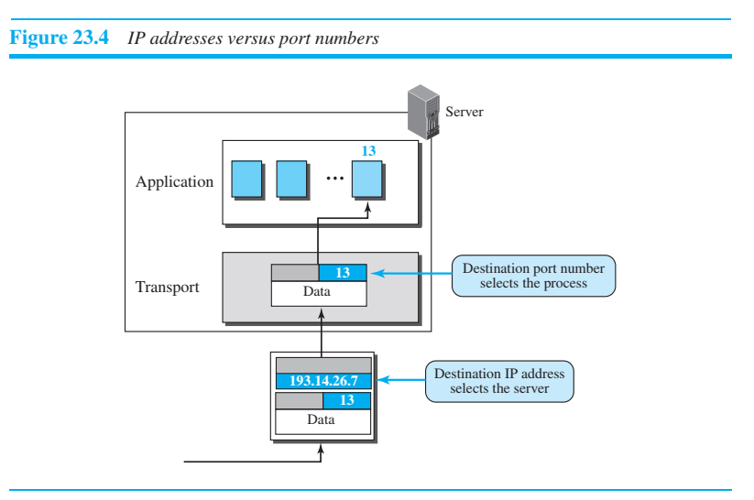
IP addresses versus port numbers

Slide 4
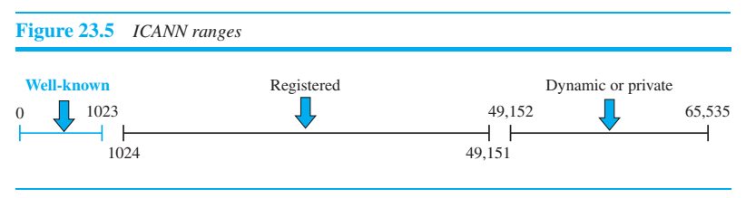
Port numbers
ICANN (Internet Corporation for assigned names and numbers) has divided the port numbers into three ranges: well-known, registered, and dynamic (or private), as shown in Figure 23.5.
Well-known ports. The ports ranging from 0 to 1023 are assigned and controlled by ICANN. These are the well-known ports. ❑ Registered ports. The ports ranging from 1024 to 49,151 are not assigned or controlled by ICANN. They can only be registered with ICANN to prevent duplication. ❑ Dynamic ports. The ports ranging from 49,152 to 65,535 are neither controlled nor registered. They can be used as temporary or private port numbers.

Slide 5
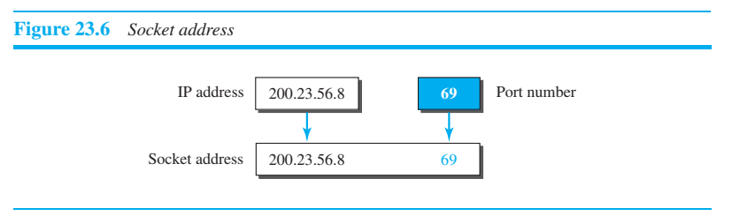
Socket Addresses
A transport-layer protocol in the TCP suite needs both the IP address and the port number, at each end, to make a connection.
The combination of an IP address and a port number is called a socket address.
The client socket address defines the client process uniquely just as the server socket address defines the server process uniquely (see Figure 23.6).
To use the services of the transport layer in the Internet, we need a pair of socket addresses: the client socket address and the server socket address.
These four pieces of information are part of the network-layer packet header and the transport-layer packet header. The first header contains the IP addresses; the second header contains the port numbers.

Slide 6
Multiplexing and Demultiplexing
Whenever an entity accepts items from more than one source, this is referred to as multiplexing (many to one);
whenever an entity delivers items to more than one source, this is referred to as demultiplexing (one to many).
The transport layer at the source performs multiplexing; the transport layer at the destination performs demultiplexing.

Slide 7
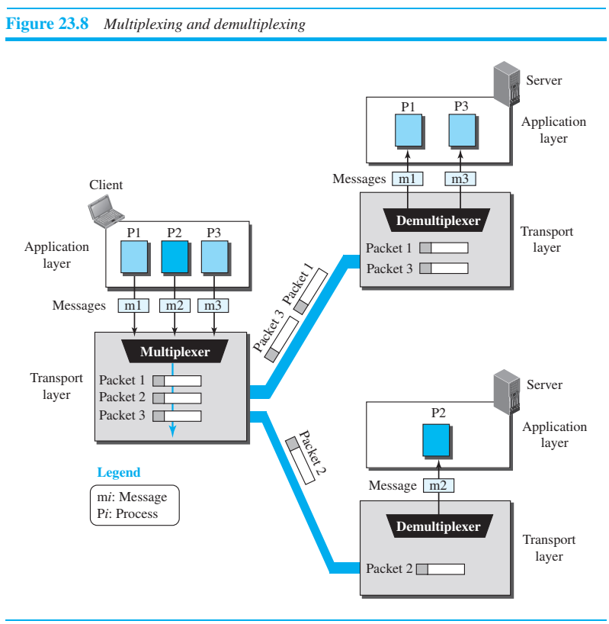

Slide 8
Flow Control
Whenever an entity produces items and another entity consumes them, there should be a balance between production and consumption rates.
If the items are produced faster than they can be consumed, the consumer can be overwhelmed and may need to discard some items.
If the items are produced more slowly than they can be consumed, the consumer must wait, and the system becomes less efficient.
Flow control is related to the first issue. We need to prevent losing the data items at the consumer site.

Slide 9
Pushing or Pulling
Delivery of items from a producer to a consumer can occur in one of two ways: pushing or pulling.
If the sender delivers items whenever they are produced⎯without a prior request from the consumer⎯the delivery is referred to as pushing.
If the producer delivers the items after the consumer has requested them, the delivery is referred to as pulling.
When the producer pushes the items, the consumer may be overwhelmed and there is a need for flow control, in the opposite direction, to prevent discarding of the items.
In other words, the consumer needs to warn the producer to stop the delivery and to inform the producer when it is again ready to receive the items.
When the consumer pulls the items, it requests them when it is ready. In this case, there is no need for flow control.

Slide 10
Flow Control at Transport Layer
In communication at the transport layer, we are dealing with four entities: sender process, sender transport layer, receiver transport layer, and receiver process.
The sending process at the application layer is only a producer. It produces message chunks and pushes them to the transport layer.
The sending transport layer has a double role: it is both a consumer and a producer. It consumes the messages pushed by the producer. It encapsulates the messages in packets and pushes them to the receiving transport layer.
The receiving transport layer also has a double role: it is the consumer for the packets received from the sender and the producer that decapsulates the messages and delivers them to the application layer.
The last delivery, however, is normally a pulling delivery; the transport layer waits until the application-layer process asks for messages.

Slide 11
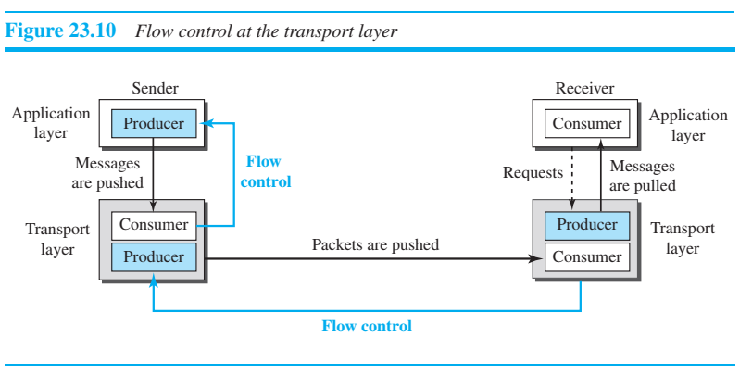
Flow control at the transport layer

Slide 12
Buffers
Although flow control can be implemented in several ways, one of the solutions is normally to use two buffers: one at the sending transport layer and the other at the receiving transport layer.
A buffer is a set of memory locations that can hold packets at the sender and receiver.
The flow control communication can occur by sending signals from the consumer to the producer.
When the buffer of the sending transport layer is full, it informs the application layer to stop passing chunks of messages;
when there are some vacancies, it informs the application layer that it can pass message chunks again.
When the buffer of the receiving transport layer is full, it informs the sending transport layer to stop sending packets.
When there are some vacancies, it informs the sending transport layer that it can send packets again.

Slide 13
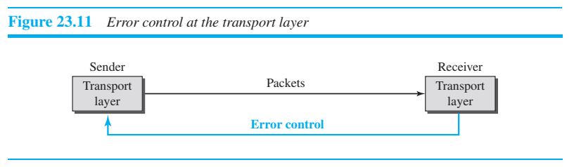
Error Control
In the Internet, since the underlying network layer (IP) is unreliable, we need to make the transport layer reliable if the application requires reliability.
Reliability can be achieved to add error control services to the transport layer.
Error control at the transport layer is responsible for 1. Detecting and discarding corrupted packets. 2. Keeping track of lost and discarded packets and resending them. 3. Recognizing duplicate packets and discarding them. 4. Buffering out-of-order packets until the missing packets arrive

Slide 14
Congestion Control
An important issue in a packet-switched network, such as the Internet, is congestion.
Congestion in a network may occur if the load on the network—the number of packets sent to the network—is greater than the capacity of the network—the number of packets a network can handle.
Congestion control refers to the mechanisms and techniques that control the congestion and keep the load below the capacity.
We may ask why there is congestion in a network. Congestion happens in any system that involves waiting.
For example, congestion happens on a freeway because any abnormality in the flow, such as an accident during rush hour, creates blockage.
Congestion in a network or internetwork occurs because routers and switches have queues—buffers that hold the packets before and after processing.

Slide 15
Congestion Control
Congestion in a network or internetwork occurs because routers and switches have queues—buffers that hold the packets before and after processing.
A router, for example, has an input queue and an output queue for each interface.
If a router cannot process the packets at the same rate at which they arrive, the queues become overloaded and congestion occurs.
Congestion at the transport layer is actually the result of congestion at the network layer, which manifests itself at the transport layer.

Slide 16
Connectionless and Connection-Oriented Protocols
A transport-layer protocol, like a network-layer protocol, can provide two types of services: connectionless and connection-oriented.
The nature of these services at the transport layer, however, is different from the ones at the network layer.
At the network layer, a connectionless service may mean different paths for different datagrams belonging to the same message.
At the transport layer, we are not concerned about the physical paths of packets (we assume a logical connection between two transport layers).
Connectionless service at the transport layer means independency between packets; connection-oriented means dependency.

Slide 17
Connectionless Service
In a connectionless service, the source process (application program) needs to divide its message into chunks of data of the size acceptable by the transport layer and deliver them to the transport layer one by one.
The transport layer treats each chunk as a single unit without any relation between the chunks.
When a chunk arrives from the application layer, the transport layer encapsulates it in a packet and sends it.
To show the independency of packets, assume that a client process has three chunks of messages to send to a server process. The chunks are handed over to the connectionless transport protocol in order.
However, since there is no dependency between the packets at the transport layer, the packets may arrive out of order at the destination and will be delivered out of order to the server process (Figure 23.14)

Slide 18
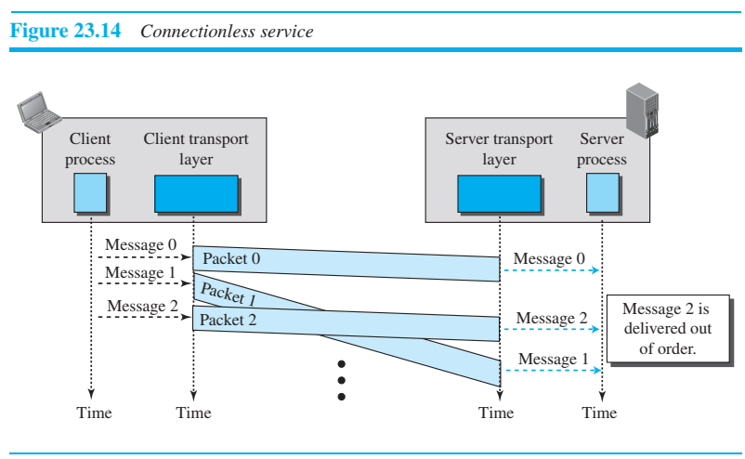
Connectionless Service

Slide 19
Connectionless Service
The situation would be worse if one of the packets were lost.
Since there is no numbering on the packets, the receiving transport layer has no idea that one of the messages has been lost.
It just delivers two chunks of data to the server process.
The above two problems arise from the fact that the two transport layers do not coordinate with each other.
The receiving transport layer does not know when the first packet will come nor when all of the packets have arrived.
We can say that no flow control, error control, or congestion control can be effectively implemented in a connectionless service.

Slide 20
Connection-Oriented Service
In a connection-oriented service, the client and the server first need to establish a logical connection between themselves.
The data exchange can only happen after the connection establishment. After data exchange, the connection needs to be torn down (Figure 23.15).
As we mentioned before, the connection-oriented service at the transport layer is different from the same service at the network layer.
In the network layer, connection oriented service means a coordination between the two end hosts and all the routers in between.
At the transport layer, connection-oriented service involves only the two hosts; the service is end to end.
This means that we should be able to make a connection-oriented protocol at the transport layer over either a connectionless or connection-oriented protocol at the network layer.
Figure 23.15 shows the connection establishment, data-transfer, and tear-down phases in a connection-oriented service at the transport layer.
We can implement flow control, error control, and congestion control in a connection oriented protocol.

Slide 21
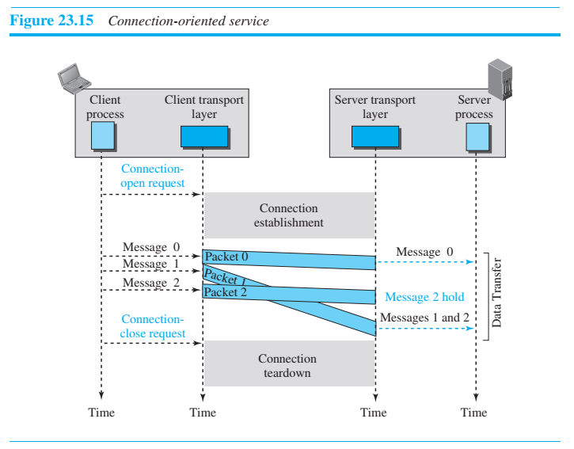
Connection-Oriented Service

